Slide 1
Title: Sales Analysis Dashboard: Amazon Sales Data Visualization Name: Shrinivas Pattar Date: 18-07-2024

Slide 2
Introduction:
This presentation provides an analysis of Amazon sales data from 2010 to 2017. The aim is to identify trends and patterns in sales over time and across different regions and sales channels.

Slide 3
Objectives
Visualize monthly sales trends over the specified period. Compare total sales by region. Provide interactive filters for more detailed analysis

Slide 4
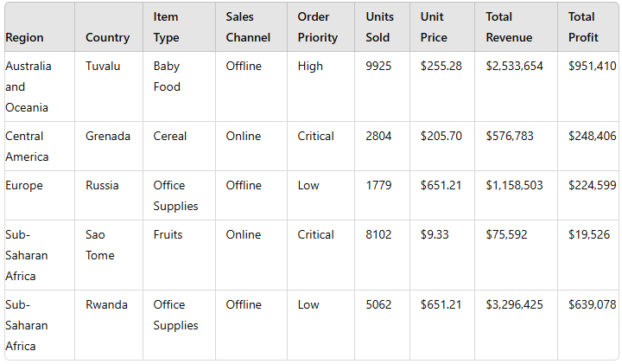
Data Source

Slide 5
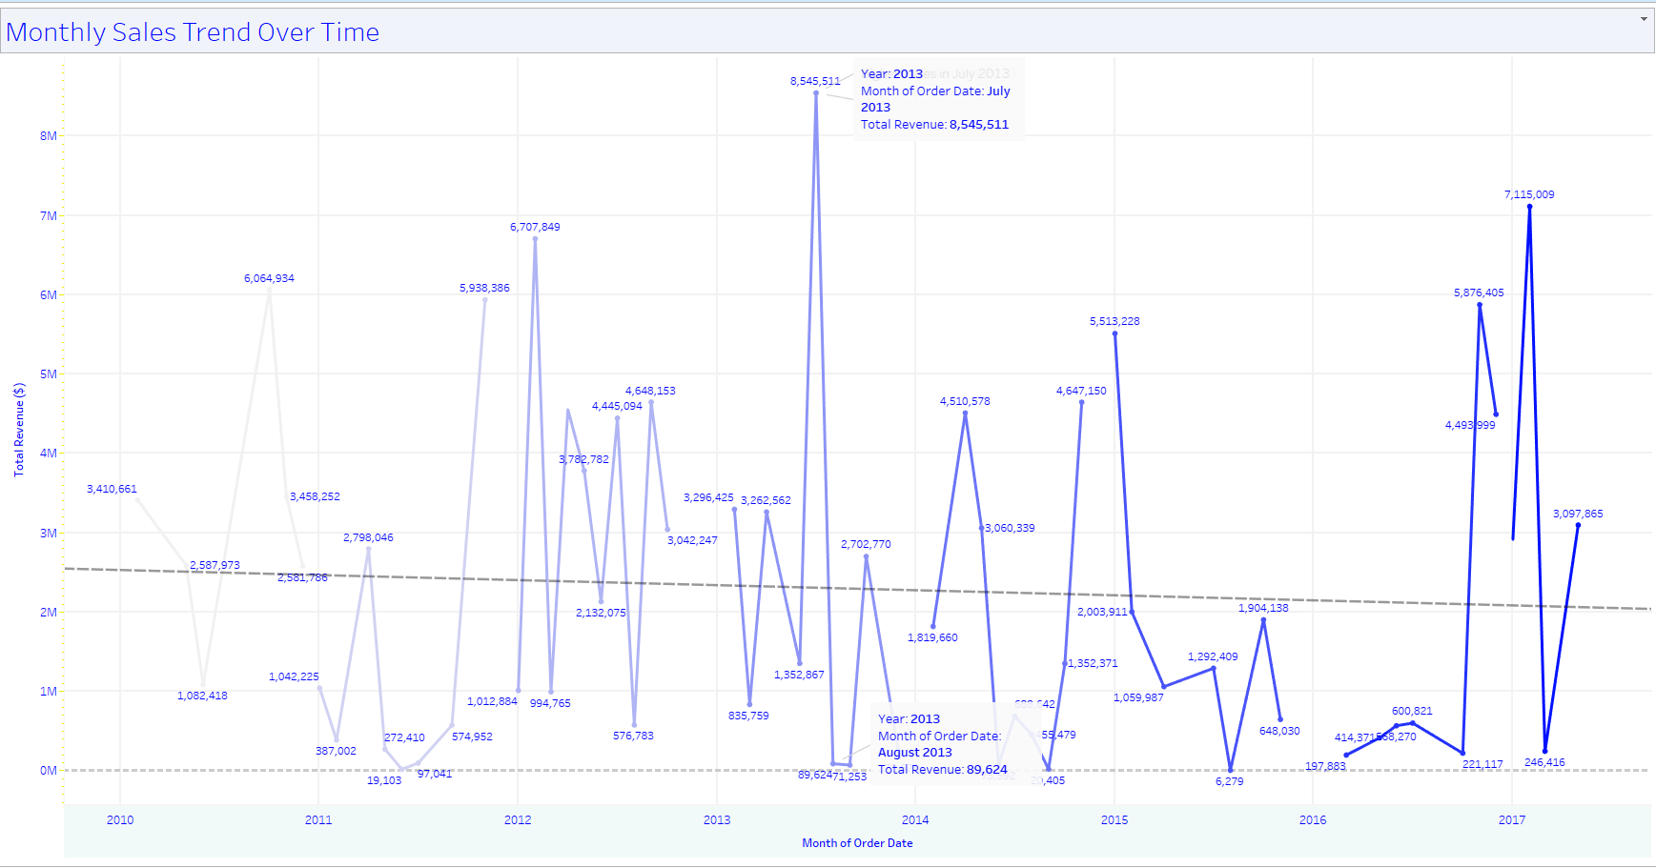
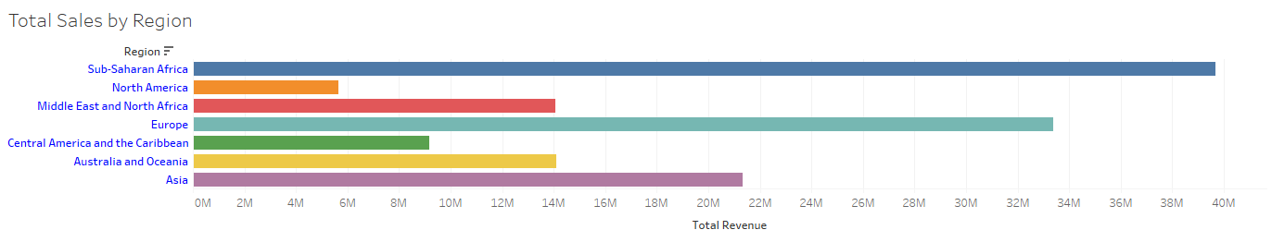
Data Cleaning: The raw data was cleaned to remove inconsistencies and errors. Data Visualization: Tableau Public Desktop was used to create interactive visualizations. Analysis: Monthly sales trends were analyzed using a line chart, and total sales by region were analyzed using a bar chart.

Slide 6
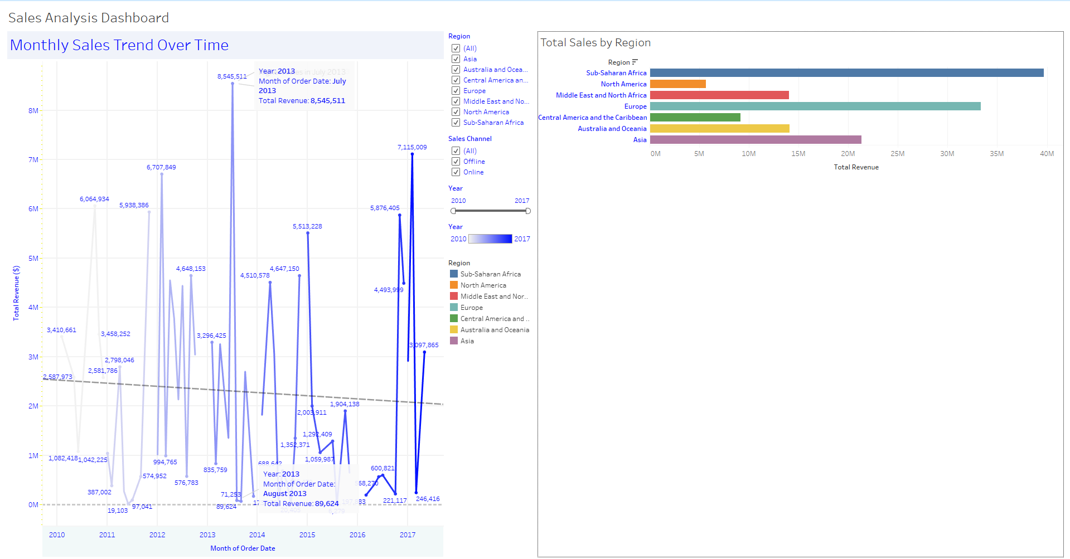
Dashboard Overview
Main Components: Monthly Sales Trend Over Time (Line Chart) Total Sales by Region (Bar Chart) Interactive Filters (Year, Region, Sales Channel)
Interactive Features: Users can filter the data by year, region, and sales channel. Tooltips provide detailed information on hover.

Slide 7
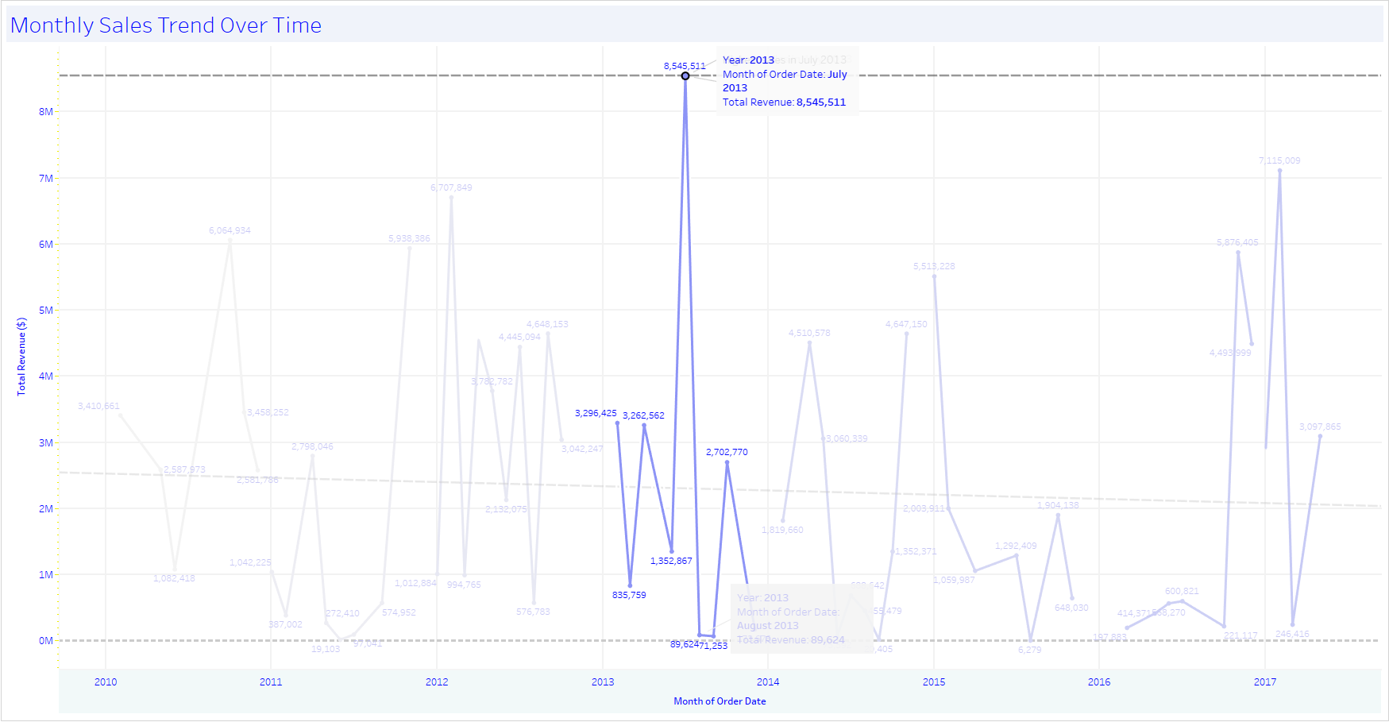
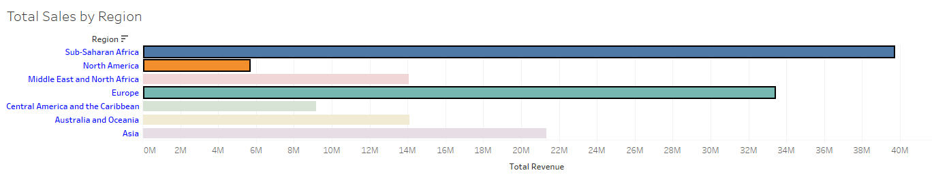
Key Findings
Monthly Sales Trends: A significant peak in sales was observed in July 2013. There are noticeable fluctuations in sales over the years.
Total Sales by Region: Sub-Saharan Africa had the highest total revenue among all regions. North America and Europe also showed substantial sales.

Slide 8
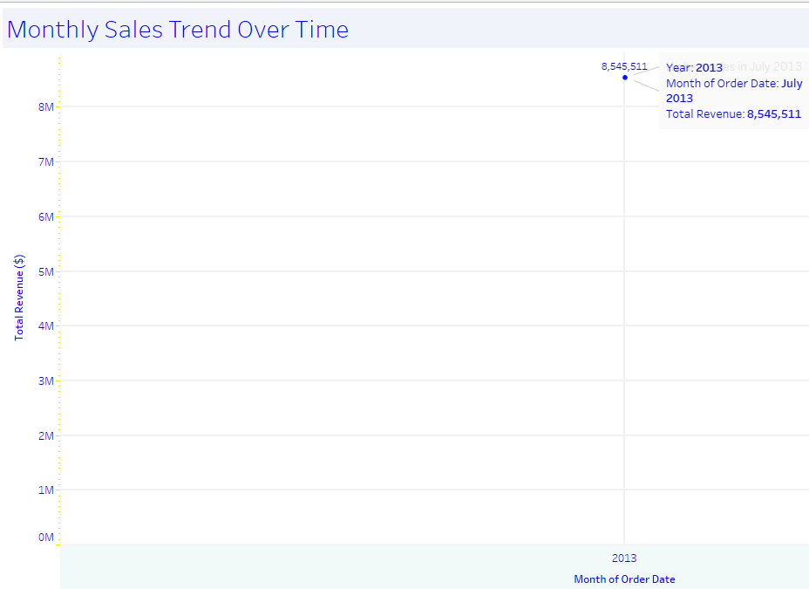
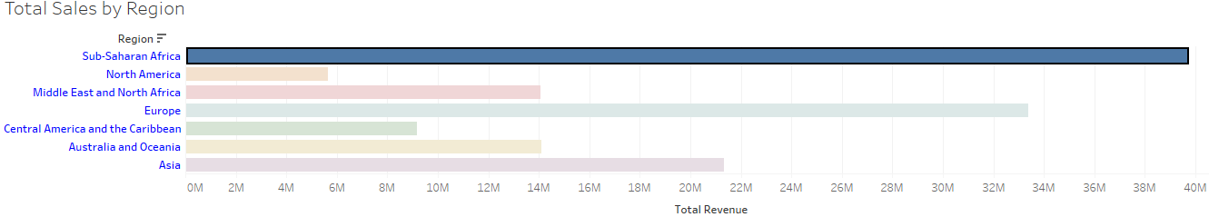
Insights and Recommendations
Sales Peaks: The peak in July 2013 suggests a possible major event or promotion that drove sales. Further investigation into marketing campaigns or product launches during that period is recommended.
Regional Performance: Sub-Saharan Africa's high sales indicate strong market performance. Consider exploring the factors contributing to this success and applying similar strategies to other regions.
Sales Channels: Analyze the performance of online vs. offline sales channels to optimize sales strategies.

Slide 9
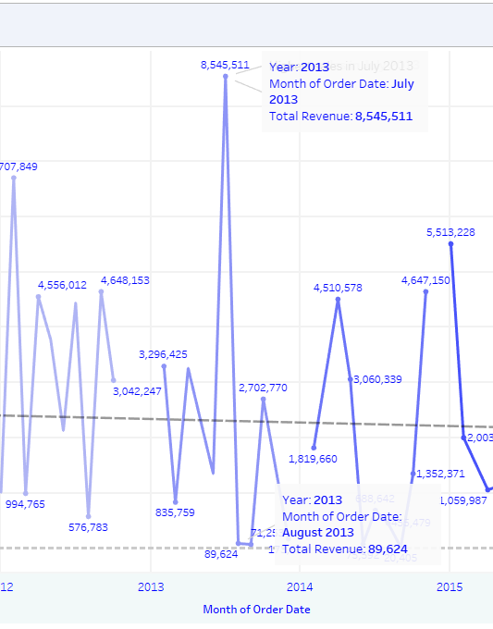
Conclusion
This analysis provides valuable insights into Amazon's sales trends and regional performance from 2010 to 2017. The interactive dashboard facilitates detailed exploration of the data, helping to inform strategic decisions.

Slide 10
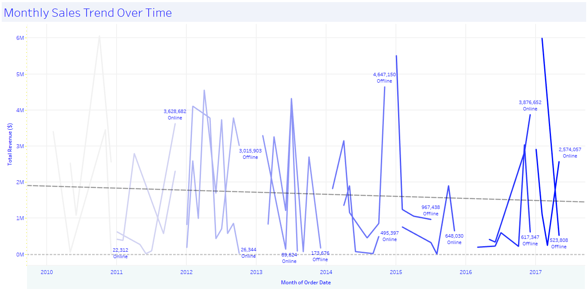
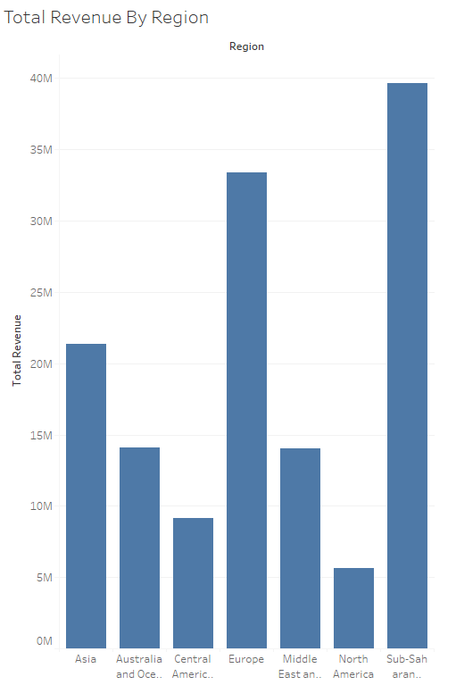
Appendices
Appendix A: Tableau Dashboard Screenshots
Monthly Sales Trends Over Time
Description: Line chart showing total revenue for each month from 2010 to 2017, highlighting significant peaks.
Total Sales by Region
Description: Bar chart comparing total revenue by region.
Sales Channel Performance
Description: Comparison of online vs. offline sales.
Order Priority Impact
Description: Analysis of how different order priorities affect sales and profit.
Appendix B: Methodology Details
Data Collection
Source: Amazon's sales records from 2010 to 2017.
Format: CSV format with fields such as Region, Country, Item Type, Sales Channel, etc.
Data Cleaning and Preparation
Removed duplicates and irrelevant fields.
Handled missing values through imputation or removal.
Converted data types as necessary.
Analytical Techniques
Tools: Tableau Public Desktop.
Methods: Time Series Analysis, Comparative Analysis, Profitability Analysis.
Assumptions and Limitations
Assumptions: Accuracy and completeness of data, consistent seasonal trends.
Limitations: Data limited to 2010-2017, external factors not considered.

